Slide 1
AI developer bootcamp: Knowledge & Search
James Carpinter
CTO, Zarmada | Microsoft Regional Director
james@zarmada.com | @jamescarpinter

Slide 2
How do I answer my users’ questions?
How do I understand the meaning of natural language, not just its component parts?
Language
Dynamics 365
Skype
Knowledge
Speech
Browser
Azure Bot Service
Cognitive Services
Vision
Cortana
Web
Azure ML
Cognitive Toolkit

Slide 3






Academic Knowledge
Knowledge Exploration
Entity Linking
QnA Maker
Recommendations*
Custom Decision

Slide 4
Academic Knowledge
Knowledge Exploration
Entity Linking
QnA Maker
Recommendations*
Custom Decision

Slide 5
QnA Maker
Train a NLP Q&A model using new & existing FAQs
Actively learns: offers closest match to user & then improves
NuGet package available for Bot Framework; don’t need to use it with bots though
Need more? Look to Azure Search and integrate manually
Extract questions & answers
Add new or from URLs, docs, editorial content
Diff, train, test, publish
See it in action then publish an endpoint
Integrate it with your app
REST API, add to a bot, or generate a new bot
switch (activity.GetActivityType())
{
case ActivityTypes.Message:
await Conversation.SendAsync (activity, () => new BasicQnAMakerDialog());
break;
...
}

Slide 6
Academic Knowledge
Knowledge Exploration
Entity Linking
QnA Maker
Recommendations*
Custom Decision

Slide 7
Entity Linking
Understand – and not just parse – natural language
Post to /entitylinking/v1.0/link

Slide 8
Academic Knowledge
Knowledge Exploration
Entity Linking
QnA Maker
Recommendations*
Custom Decision

Slide 9
Advanced
Knowledge Exploration
Interactive search using natural language over structured data sets
Convert NLP to structured queries; improve UX with auto-complete & histograms
Academic Knowledge
Search the Microsoft Academic Graph using natural language queries
Based on Bing indexes & knowledgebase of studies, authors, institutions, papers, venues, & events
Multi-step process:
Build a schema
Prepare data
Generate index
Build a grammar
Interpret natural language
Complex search queries
Histogram of results
Search graph by pattern

Slide 10
What do I use then?
EASY
MODERATE
ADVANCED
QnA Maker
Build a new bot or extend an existing one by adding your FAQs in just minutes
Entity Linking
Easy to use but applies to a more mature NLP process or web experience
Academic Knowledge
Advanced domain-specific search service
Knowledge Exploration
Requires you to build schema, re-format data, and define a schema for NLP before you can start

Slide 11
Demo
QnA Maker

Slide 12







Bing Web Search
Bing Image Search
Bing Video Search
Bing News Search
Bing Autosuggest
Bing Entity Search
Bing Custom Search

Slide 13







Bing Search APIs
Web Search
Custom Search
Enhanced Search and Filtering Capabilities
Image Search
Web-
Scale
Secure (HTTPs)
High Performance
Video Search
REST
schema.org
JSON
News Search
Autosuggest
Ongoing Improvements and Support
Spell Check

Slide 14
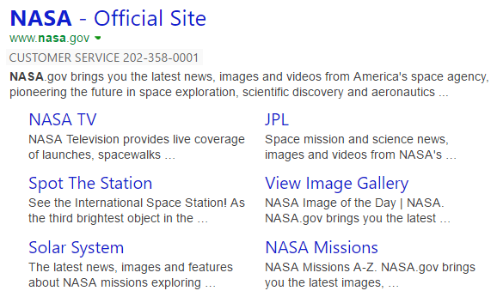

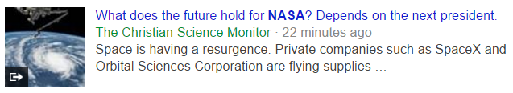
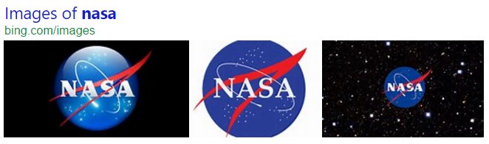
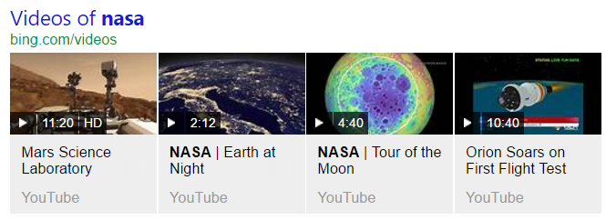
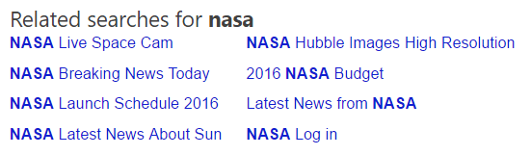
Bing Web Search
Get relevant web and answer results and metadata with one API call
https://api.cognitive.microsoft.com/bing/v7.0/search?q=nasa
Web
Results
Search Response
Deep Links
(1st Algo)
{
“_type”: “SearchResponse”,
“queryContent”: {…},
“webPages”: {…},
“news”: {…},
“images”: {…},
“videos”: {…},
“relatedSearches”: {…},
“rankingResponse”: {…}
}
News Results
Ranking Response
Image
Results
{
“answerType”:”WebPages”,
“resultIndex”:0,…
},
{
“answerType”:”News”,
“resultIndex”:1,…
}
Video Results
Related Searches
*screenshots show actual search results on bing.com

Slide 15
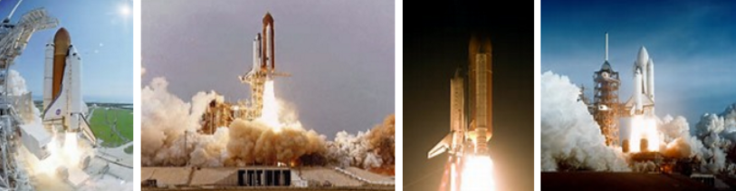
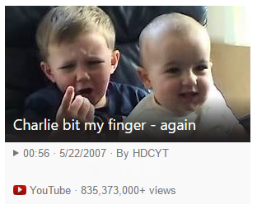
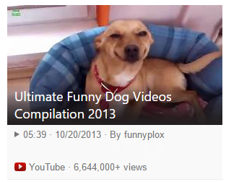
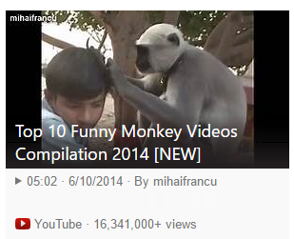
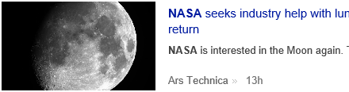
Bing Vertical Search
Get more results, features and metadata tailored to each search vertical
Image Search
https://api.cognitive.microsoft.com/bing/v7.0/images/search?q=shuttle+launch
Enhanced metadata and filters (size, license, style, freshness, color)
Image insights (entity recognition, visually similar)
source: nasa.gov
Video Search
https://api.cognitive.microsoft.com/bing/v7.0/videos/search?q=viral+videos
Enhanced metadata and filters (price, resolution, length, freshness)
Motion thumbnails (video preview)
source: youtube.com
News Search
https://api.cognitive.microsoft.com/bing/v7.0/news/search?q=lunar+landing
News by category/market, and trending news
Rich article metadata (featured entities)
source: arstechnica.com
*screenshots show actual search results in bing.com

Slide 16

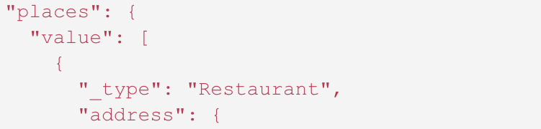

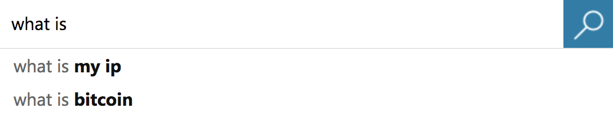


Bing Specialized Search
Understand and act on natural language with contextual search
Entity Search
https://api.cognitive.microsoft.com/bing/v7.0/entities?q=coffee
Bring rich context about people, places, things, and local businesses
Based on query & location, returns content, images, links with licenses
source: microsoft.com
Autosuggest
https://api.cognitive.microsoft.com/bing/v7.0/suggestions?q=what+is
Intended to improve custom search experiences
Call on each character press to build Bing-like drop-down assistance
source: bing.com
Custom Search
https://api.cognitive.microsoft.com/bingcustomsearch/v5.0/search?q=coffee
Site search: across your sites, control top results & rankings
Vertical search: target specific sites, deploy externally/internally

Slide 17
How do I answer my users’ questions? QnA Maker
How do I understand the meaning of natural language, not just its component parts?
Entity Linking
Language
Dynamics 365
Skype
Knowledge
Speech
Browser
Azure Bot Service
Cognitive Services
Vision
Cortana
Web
Azure ML
Cognitive Toolkit

